Slide 1
Summer Months Strategy Portfolio Analysis
Layla Gallez
Don Walker
Jose Rodriguez
Alex Osterholt
November 29, 2018

Slide 2
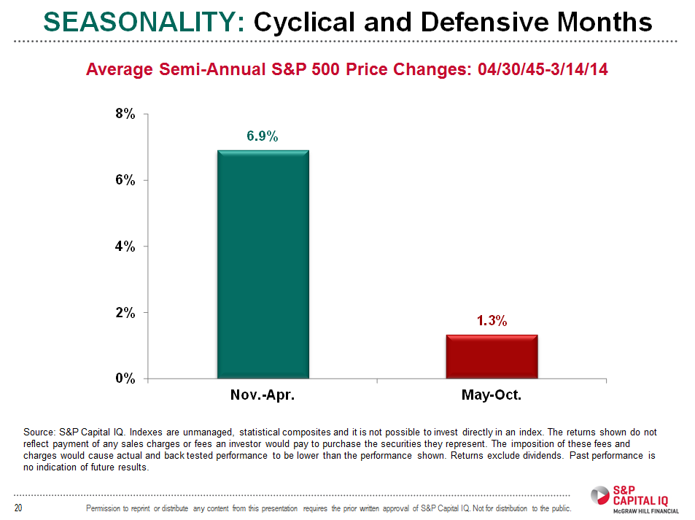
Seasonality of Returns
Can you really buy low and sell high? Maybe it depends on the season.

Slide 3
Thesis - 'Sell In May And Go Away'
What is 'Sell In May And Go Away'?
Sell in May and go away is a well-known trading adage that warns investors to sell their stock holdings in May to avoid a seasonal decline in equity markets. If a trader follows the sell-in-May-and-go-away strategy, the trader sells stock holdings in May and invests again in the equity market in November to avoid the typically volatile May to October period. Some investors find this strategy more rewarding than staying in the equity markets throughout the year.

Slide 4
A Tale of Many Seasons
Average Total Return from 1990-2018 by Season

Slide 5
SEASONALITY: Six-Month Results by Over Time

Slide 6
Seasonality Conclusions
Evidence of the “Halloween Effect” or “Sell in May” strategy
“Sell in May” is defined as investing in the historically best months (Nov - May) and then switching to bonds from May – Oct
Initial studies showed that this effect has been in place since 1950
More recent studies show that this effect in 108 countries from data as far back as 1693 (Jacobsen & Zhang, 2012)
Not clear what causes this effect

Slide 7
“Sell in May”
Research is not clear what causes this strategy, but possible explanations are:
Vacation months lead to risk aversion
Optimism at the beginning of the year

Slide 8
Seasonality Conclusions by Sector
From November to April, Consumer Discretionary, Industrials, and Materials performed the best
Consumer Discretionary - holiday shopping
Industrials/Materials – corporate budgets are the highest at the beginning of the year for capex spending
From May to October, Consumer Staples and Healthcare performed the best
Consumer Discretionary and Materials performed the worst

